Slide 1
Regression Introduction and Estimation Review
Dr. Frank Wood
TexPoint fonts used in EMF.
Read the TexPoint manual before you delete this box.: AAAAAA

Slide 2
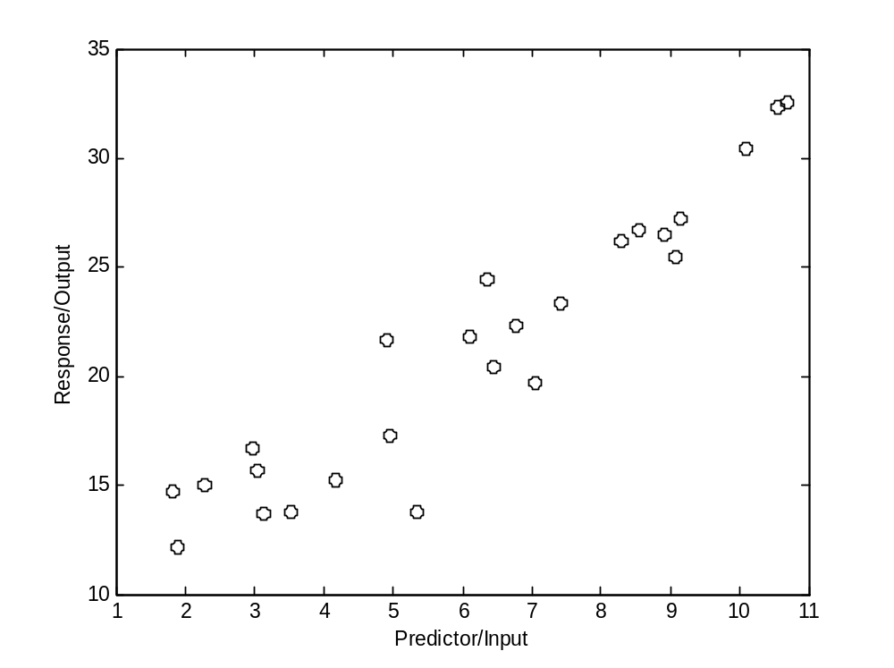
Quick Example – Scatter Plot

Slide 3
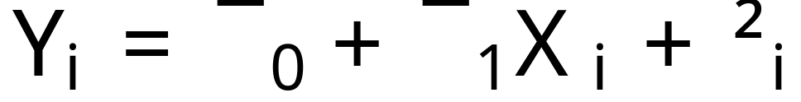
Linear Regression
Want to find parameters for a function of the form
Distribution of error random variable not specified

Slide 4


Quick Example – Scatter Plot

Slide 5
Formal Statement of Model
Y_{i} value of the response variable in the i^{th} trial
¯₀ and ¯₁ are parameters
X_{i} is a known constant, the value of the predictor variable in the i^{th} trial
²_{i} is a random error term with mean E(²_{i}) and variance V(²_{i}) = ¾²
i = 1,…,n

Slide 6
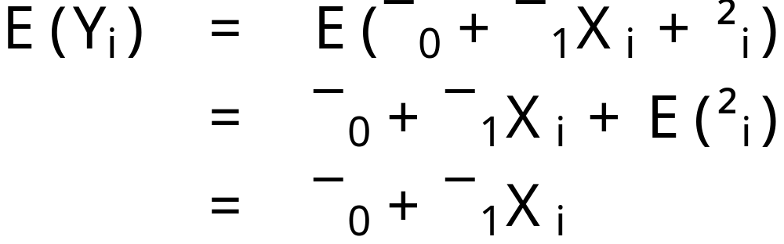
Properties
The response Y_{i} is the sum of two components
  1) Constant term ¯₀ + ¯₁ X_{i}
  2) Random term ²_{i}
The expected response is

Slide 7
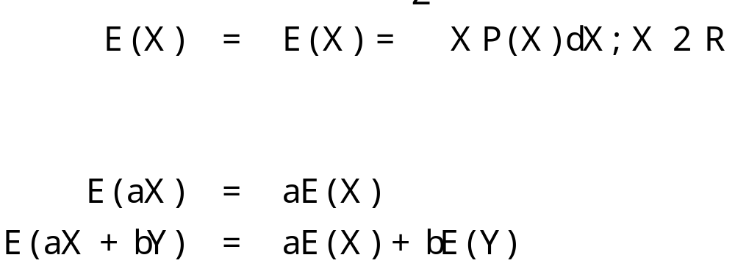
Expectation Review
Definition
Linearity property
Obvious from definition

Slide 8
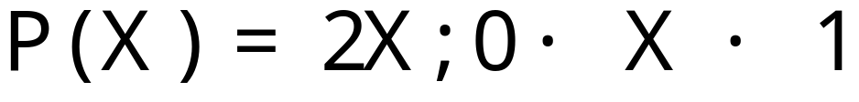
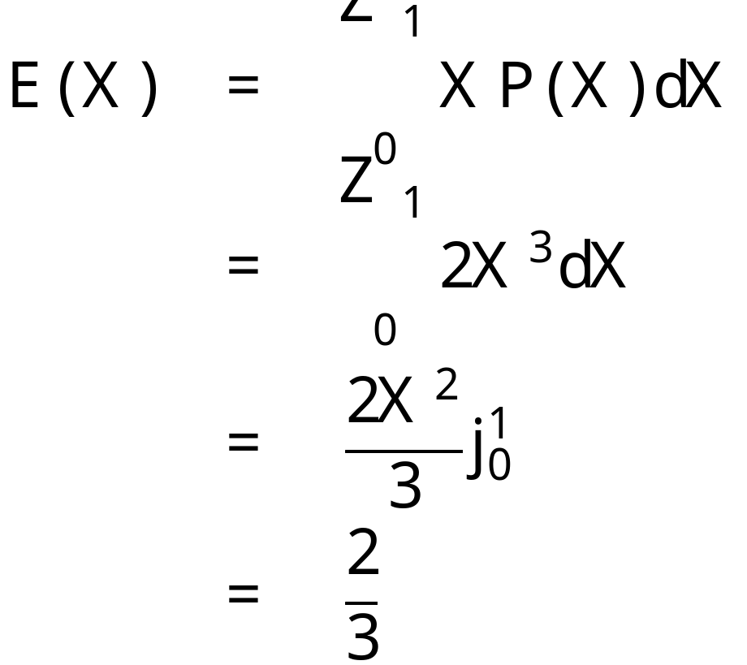
Example Expectation Derivation
Expectation
draw distro on board

Slide 9

Expectation of a Product of Random Variables
If X,Y are random variables with joint distribution j(X,Y) then the expectation of the product is given by

Slide 10
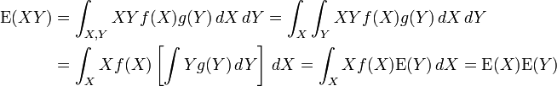
Expectation of a product of random variables
What if X and Y are independent?
  If X and Y are independent with density functions f and g respectively then

Slide 11
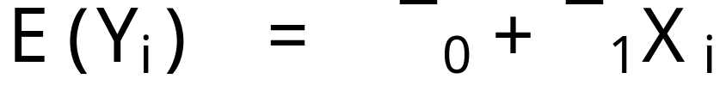
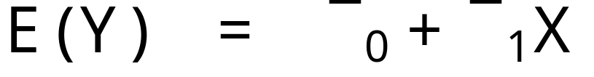
Regression Function
The response Y_{i} comes from a probability distribution with mean
This means the regression function is
Since the regression function relates the means of the probability distributions of Y for a given X to the level of X

Slide 12
Error Terms
The response Y_{i} in the i^{th} trial exceeds or falls short of the value of the regression function by the error term amount ²_{i}
The error terms ²_{i} are assumed to have constant variance ¾²

Slide 13
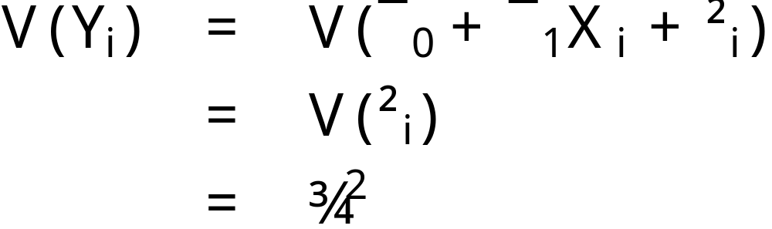
Response Variance
Responses Y_{i} have the same constant variance

Slide 14
Variance (2nd central moment) Review
Continuous distribution
Discrete distribution

Slide 15
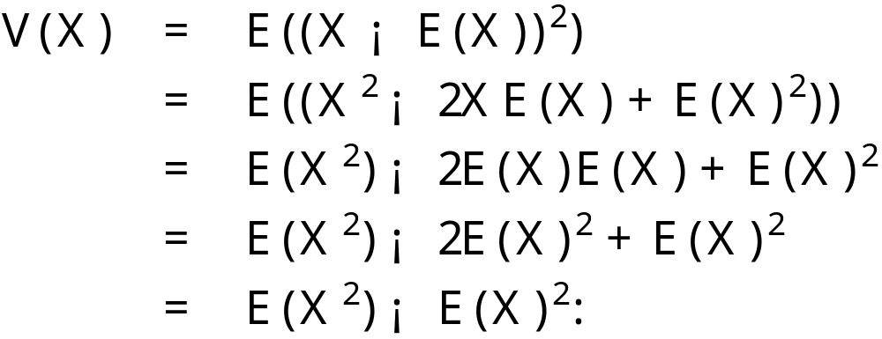
Alternative Form for Variance

Slide 16
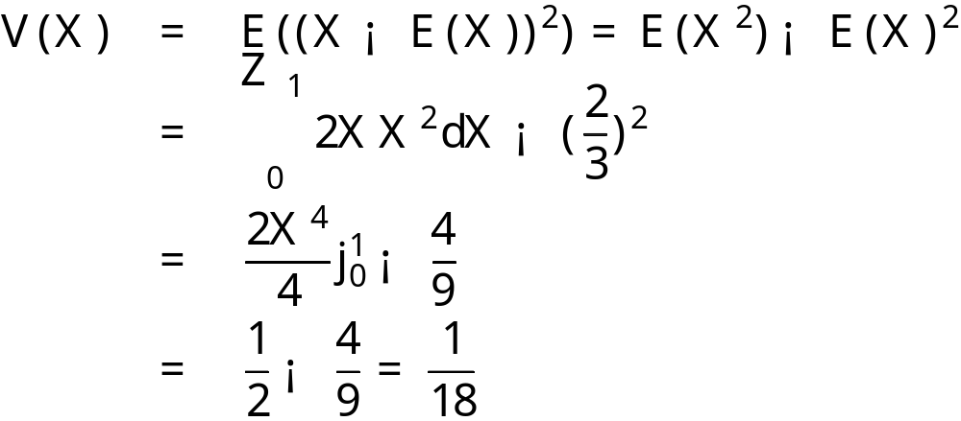
Example Variance Derivation
Same as before

Slide 17
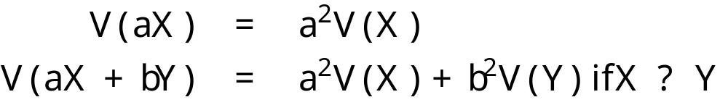
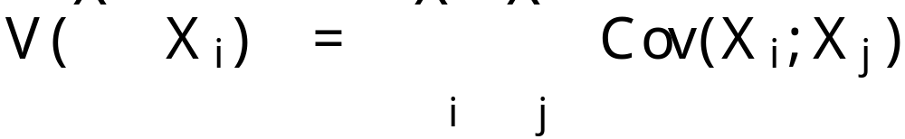
Variance Properties
More generally

Slide 18
Covariance
The covariance between two real-valued random variables X and Y, with expected values E(X) = ¹ and E(Y) = º is defined as
Which can be rewritten as

Slide 19
Covariance of Independent Variables
If X and Y are independent, then their covariance is zero. This follows because under independence
and then

Slide 20
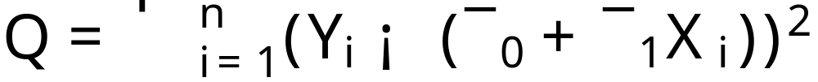
Least Squares Linear Regression
Seek to minimize
By careful choice of b₀ and b₁ where b₀ is a point estimator for ¯₀ and b₁ is the same for ¯₁
How?

Slide 21
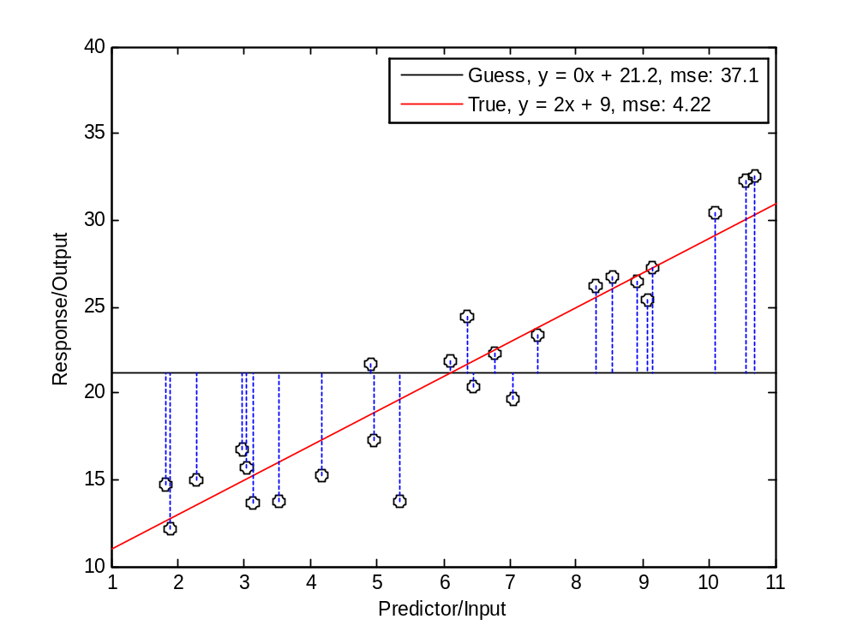
Guess #1

Slide 22
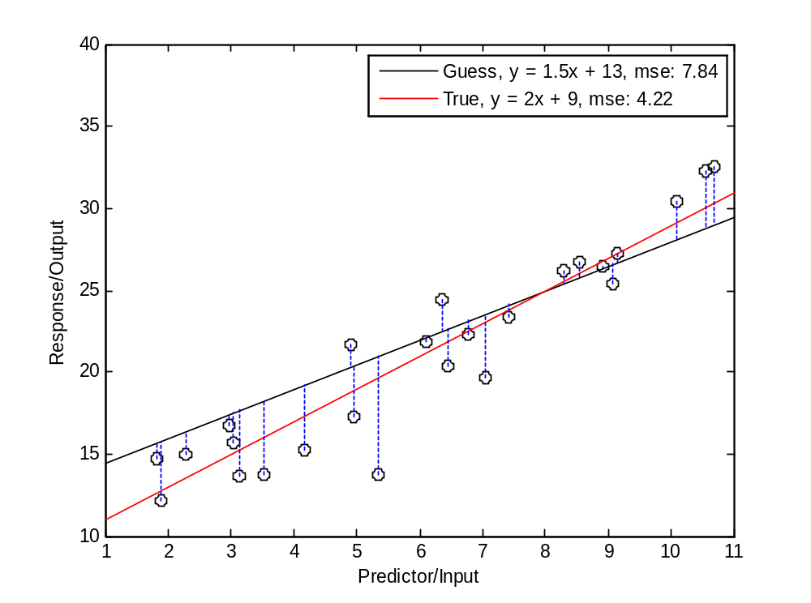
Guess #2

Slide 23
Function maximization
Important technique to remember!
  Take derivative
  Set result equal to zero and solve
  Test second derivative at that point
Question: does this always give you the maximum?
Going further: multiple variables, convex optimization
Draw some pictures

Slide 24
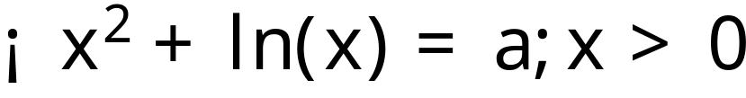
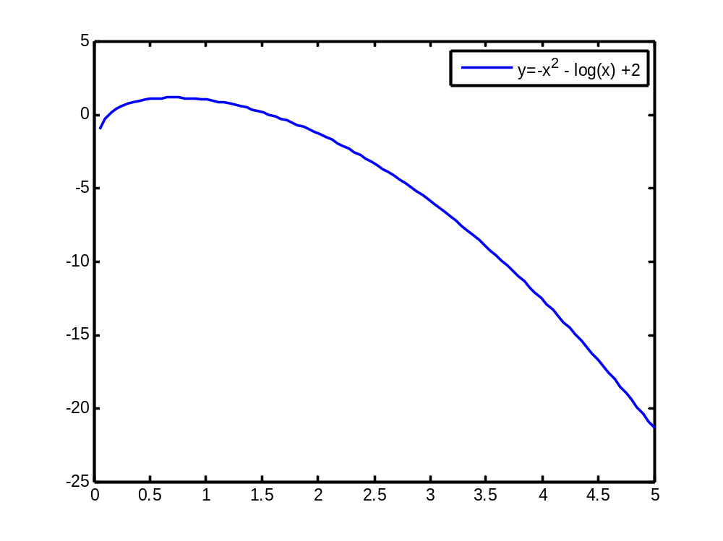
Function Maximization
Find the maximum value of x that satisfies the function
do derivative
on board

Slide 25
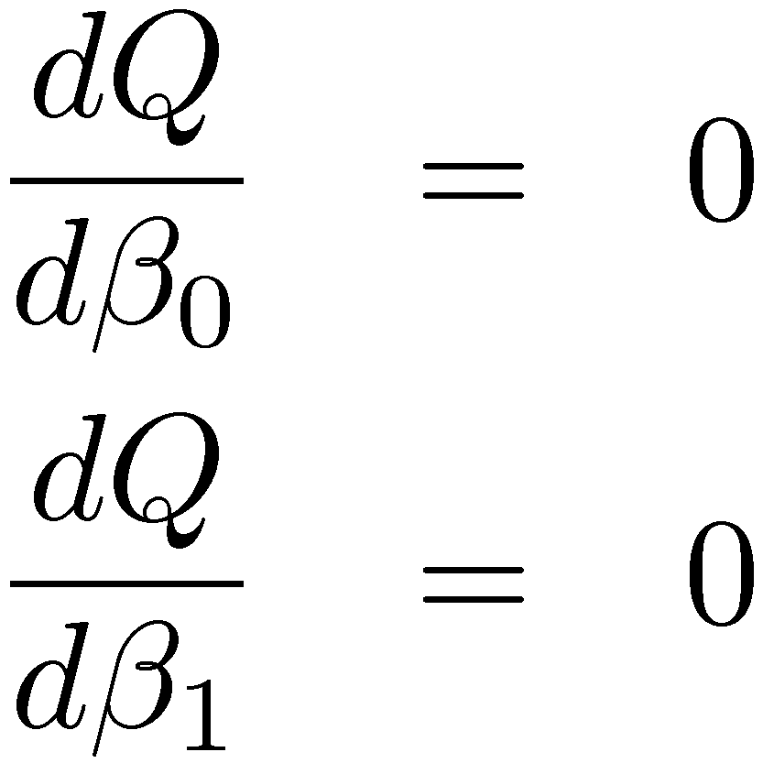
Least Squares Max(min)imization
Function to minimize w.r.t. ¯₀, ¯₁
Minimize this by maximizing –Q
Find partials and set both equal to zero
go to board

Slide 26
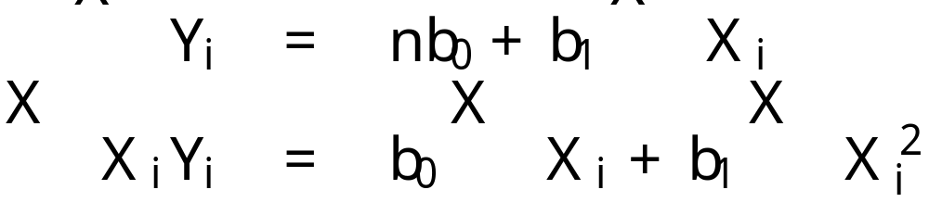
Normal Equations
The result of this maximization step are called the normal equations. b₀ and b₁ are called point estimators of ¯₀ and ¯₁ respectively
This is a system of two equations and two unknowns. The solution is given by…

Slide 27
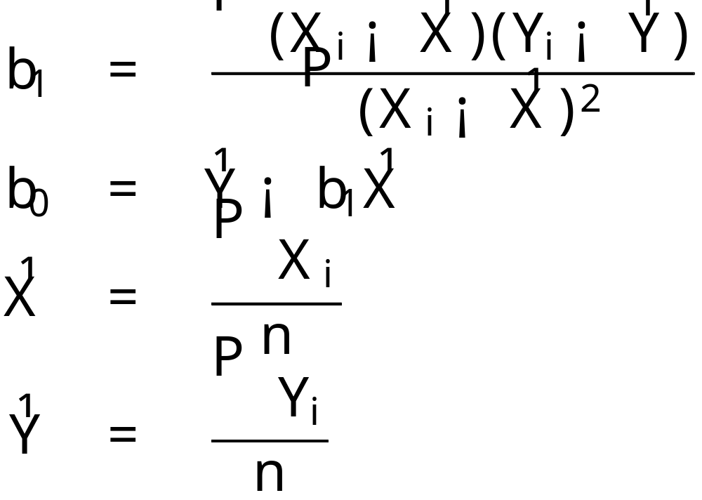
Solution to Normal Equations
After a lot of algebra one arrives at

